Slide 1

Experiential Learning Project Assessment-I
on
“Address Book in Python”
under the course | Python Programming Language (N-PCCCM304P)
Presented By BRIJESH YOGESH THAKUR
Under the Guidance of
Mrs. Mayuri Getme
Session: 2026–27 (ODD) | Department of CSE (AI&ML)

Slide 2
Contents
Problem statement
Objectives
Algorithm
Flowchart / Pseudocode
Understanding of Python logic
GitHub: account, repository creation, code upload, meaningful commits, collaboration and individual contribution
Application features: add, view, search, update and delete contacts
Permanent storage using file handling or a database

Slide 3


1. Problem Statement
The Need
Managing personal and professional contacts manually can become difficult as the number of contacts grows.
The project develops a Python-based Address Book that stores contact details and provides simple operations to manage them.
Required Information
Name
Phone number
Email address
Postal address
Other relevant contact information
Records should be stored permanently using file handling or a database.

Slide 4
2. Objectives
Develop a Python-based Address Book application.
Store and organize personal and professional contact information efficiently.
Provide an interactive menu-driven interface.
Allow users to add, view, search, update and delete contacts.
Maintain useful details such as name, phone number, email and postal address.
Ensure contact records are stored permanently using file handling or a database.

Slide 5


3. Main Features
ADD CONTACT
Enter and save a new contact with required details.
VIEW CONTACTS
Display all saved contacts in an organized form.
SEARCH
Find a contact quickly using a suitable detail such as name or phone.
UPDATE
Edit existing contact information when details change.
DELETE
Remove an unwanted contact
from the address book.
PERMANENT STORAGE
Keep records available after the
program is closed.

Slide 6
4. Algorithm
Start the Address Book application.
Load existing contacts from the file/database.
Display the menu: Add, View, Search, Update, Delete, Exit.
Accept the user's choice.
Perform the selected operation on contact records.
Save changes permanently after add/update/delete operations.
Repeat the menu until the user selects Exit.
End the program.

Slide 7











5. Flowchart / Program Logic
START
Load contacts
Display menu
If Exit = No
→ return to menu
User choice
Add / View / Search / Update / Delete
Save changes
If Exit = Yes → END
Exit?

Slide 8

6. Pseudocode
BEGIN
Load contacts REPEAT
Display menu Read choice
IF choice = Add
Enter and store contact
ELSE IF choice = View Display contacts
ELSE IF choice = Search Find matching contact
ELSE IF choice = Update
Modify selected contact ELSE IF choice = Delete
Remove selected contact
ELSE IF choice = Exit Stop
END IF
Save updated records
S. B. JAIN INSTITUTE OF TECHNOLOGY MANAGEMENT AND RESEARCH, NAGPUR
UNTIL choice = Exit

Slide 9



7. Understanding of Python Logic
Variables & Data
Store fields such as name, phone, email and address. A contact can be represented using a dictionary or a structured record.
Functions
Separate operations into functions such as add_contact(), view_contacts(), search_contact(), update_contact() and delete_contact().
Conditions & Loops
if/elif handles menu choices, while loops keep the menu running until Exit is selected.
File Handling
Use a file to save contact records permanently. Read records when the application starts and write updated records after changes.
Error Handling
Validate user input and handle cases such as an empty address book, contact not found, or invalid menu choice.

Slide 10



8. Menu-Driven Interface
Why Menu-Driven?
It gives the user a clear and interactive way to select operations without needing to know the internal program logic.
===== ADDRESS BOOK =====
Add Contact
View Contacts
Search Contact
Update Contact
Delete Contact
Exit
Enter your choice:
User Flow
Choose an operation → enter or select contact details → perform the operation → save the updated records → return to menu.

Slide 11

9. GitHub Workflow & Collaboration
Create or use a GitHub account for the project.
Create a meaningful repository for the Address Book application.
Upload the Python source code and supporting files.
Use meaningful commits to record each major improvement.
Collaborate by sharing the repository and coordinating changes.
Show individual contribution clearly through commits and work completed.
Example Commit
“Added search and update contact functions”

Slide 12


10. Expected Result & Conclusion
Expected Result
A simple Python-based Address Book that can:
Store contact information
Organize and display records
Search contacts
Update existing details
Delete contacts
Preserve records permanently
Provide an easy menu-driven experience
Conclusion
The project applies Python programming logic to a practical real-life problem. It combines functions, conditions, loops, data handling and permanent storage in one useful application.
It also demonstrates project workflow through GitHub, meaningful commits, collaboration and individual contribution.

Slide 13
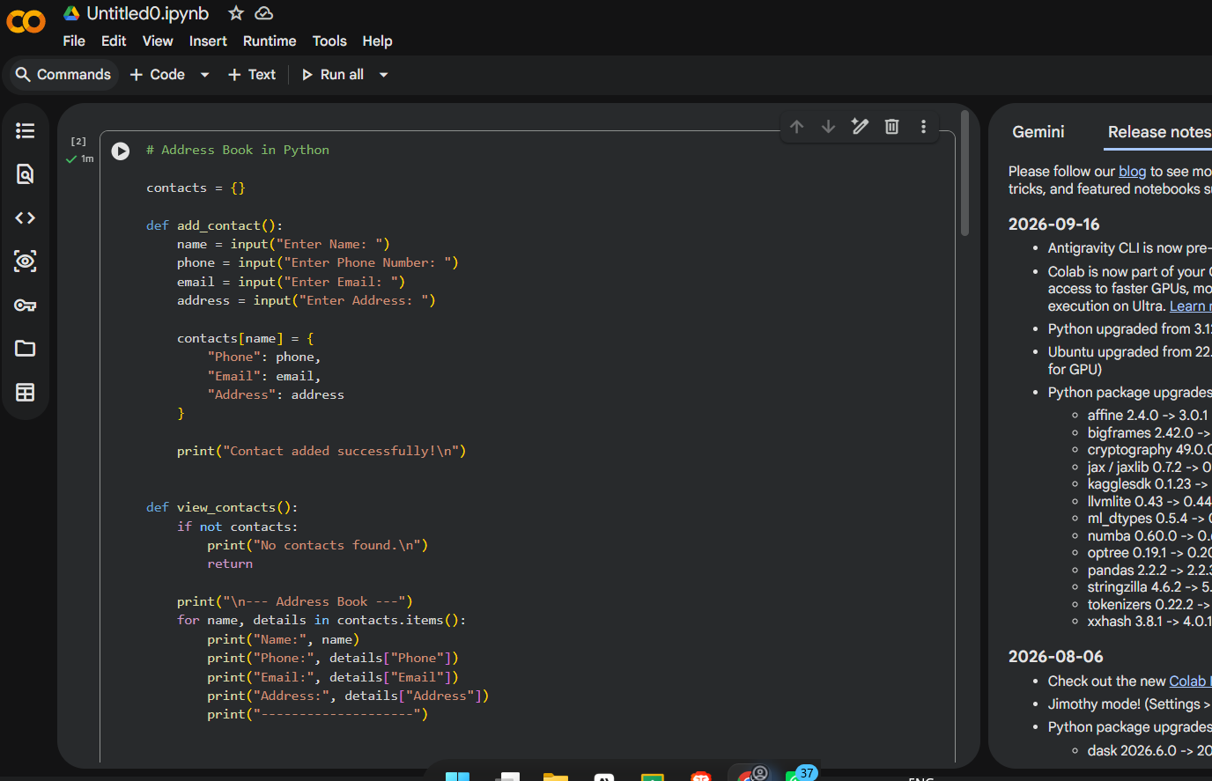
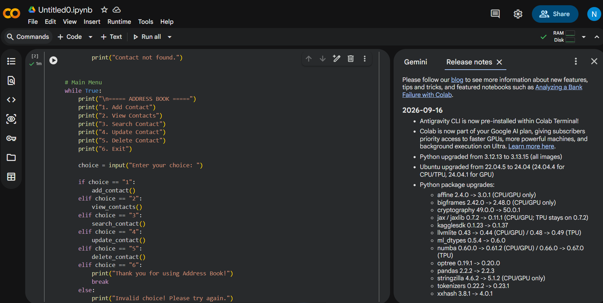
Code :-

Slide 14
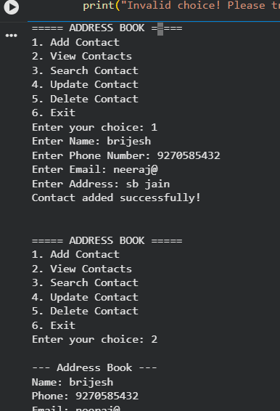
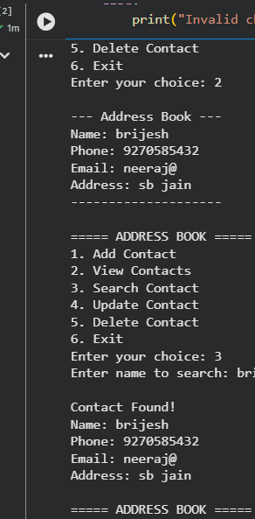
Output:-

Slide 15
THANK YOU
Address Book in Python

